Slide 1
RPA Demo
- Cross-Platform File Syncing -

Slide 2
General Overview

Slide 3
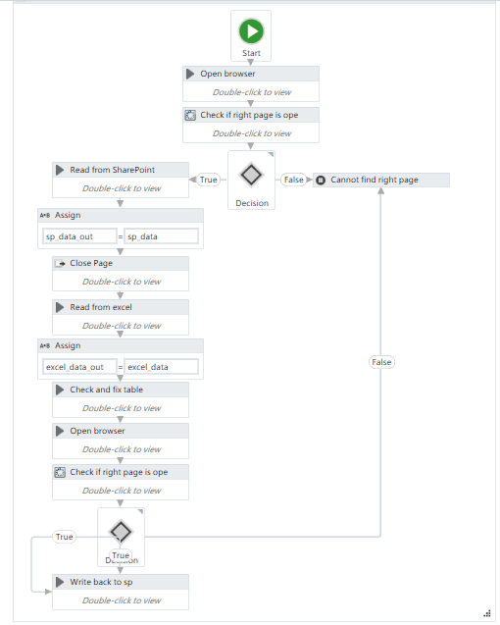
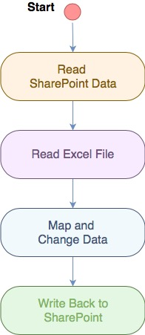

Slide 4
Main Steps

Slide 5
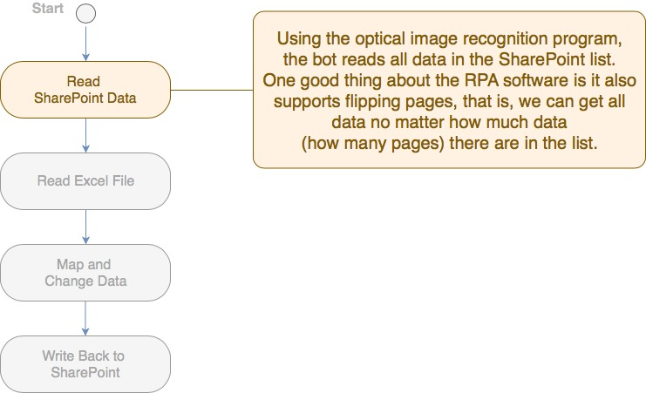

Slide 6
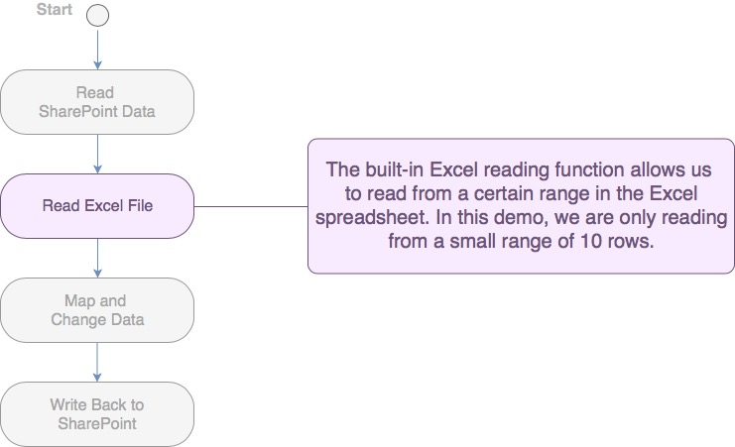

Slide 7
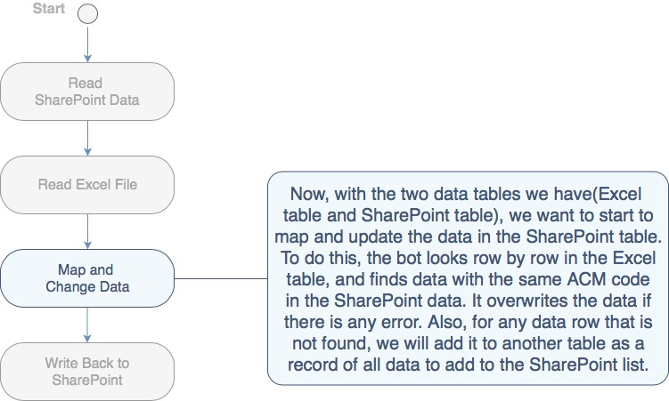

Slide 8
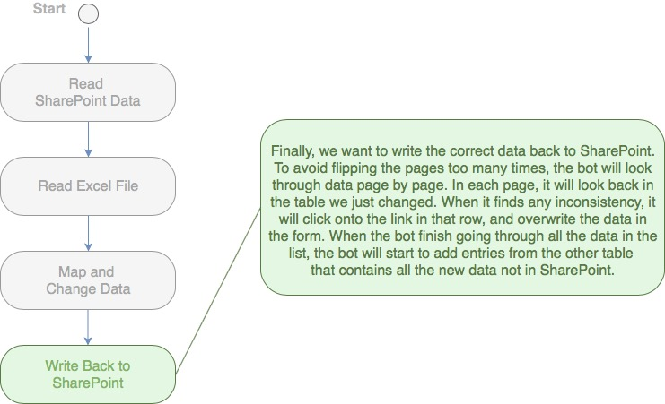

Slide 9
Demo Video

Slide 10
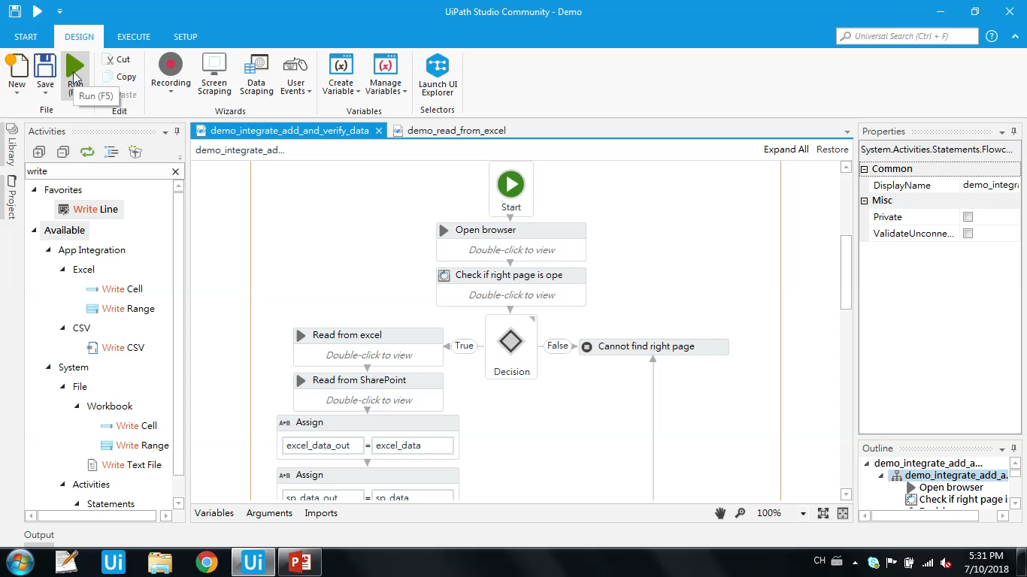

Slide 11
Conclusion
To run 100 files with around 15% error rate and 15% miss rate –
Challenging when data is not clean, or when the tables are more complicated
Takes time to learn basic programming knowledge

